Slide 1
Category review: Chips
April 2023
Retail Analytics
Brand note: If client logo is not required, use alternate title page layout right click slide thumbnail > Layout > Title

Slide 2
Notes:
To view Privacy video explaining how important data privacy is to Quantium, please click here: https://www.youtube.com/watch?v=Zq1QDAkoRzU
or here Q:\Company Reference\Brand & Design\Brand videos\Q Privacy.mp4
At Quantium, we believe that data is the behavioural footprint of humanity and that it has to be treated with the utmost care and responsibility.
Histories, attitudes, indeed lives are stored within it in ways that aren’t always apparent – and that’s what makes its potential so powerful.
To work with it responsibly, sensitively, we set ourselves the highest data privacy protection and governance standards.
We have spent 17 years perfecting privacy-by-design and secure-by-design principles. Central to this is not holding any personally identifiable information about people –
we neither receive it, and put the necessary protections in place to be unable to decipher it.
Every aspect of handling data is safeguarded: from its de-identification, to its encryption – data security is paramount and of the highest grade.
We pride ourselves on gaining the trust of iconic organisations around the world through years of securely working with their data,
and in turn the trust that builds with their stakeholders.

Slide 3
Executive summary
01
Task 1
Most sales were generated by Older singles/couples, retirees, and older families, while the least sales were from new families.
Mainstream customers generated the most sales, which we can attribute to the same customer segment having a majority of the customers.
In combined customer segments, Budget-older families, mainstream- young couples/singles, and mainstream- retirees generated the most sales while premium-new families generated the least sales.
Older singles/couples, older families, and retirees purchased more chips as compared to the rest of the segments.
Mainstream - young singles/couples and mainstream – mid-age singles/couples are more willing to pay more per packet of chips compared to other customer segments.
Kettle, Doritos, and Smiths are the top 3 best selling chip brands
02
Task 2
One control store was selected for each trial store and the values of metrics were compared in trial and pre-trial periods.
Trial stores 77 and 86 have a significant increase in total sales and the number of customers during the trial as compared to the control stores.
Trial stores 77 and 86 showed a significant increase in total sales and the number of customers during the three-month trial period unlike trial store 88 which did not show significant improvement in performance during the trial period compared to its control store.

Slide 4
01
Category

Slide 5
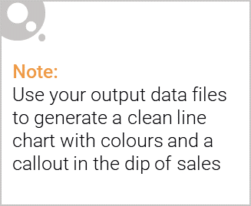
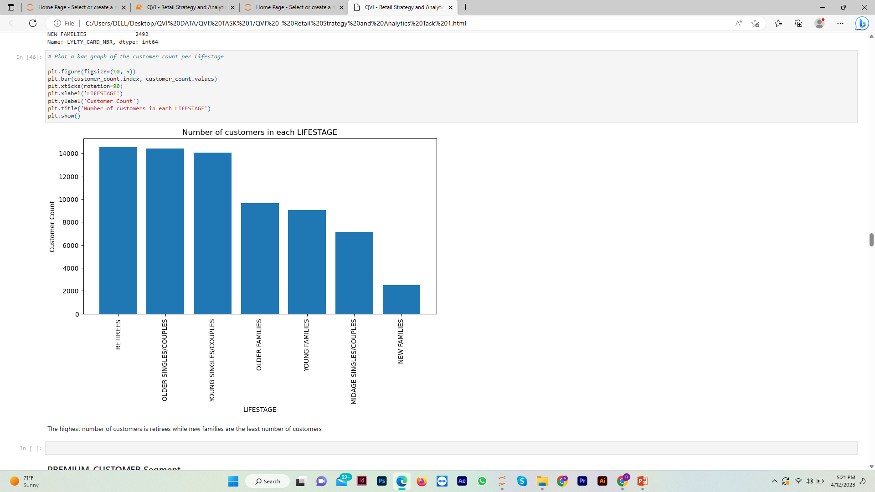
Retirees, older singles/couples, and young singles/couples were the top 3 in number of customers.

Slide 6
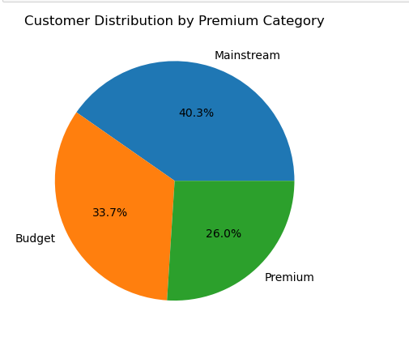
The customer numbers in terms of purchasing behaviors are fairly distributed with mainstream customers being the majority.

Slide 7

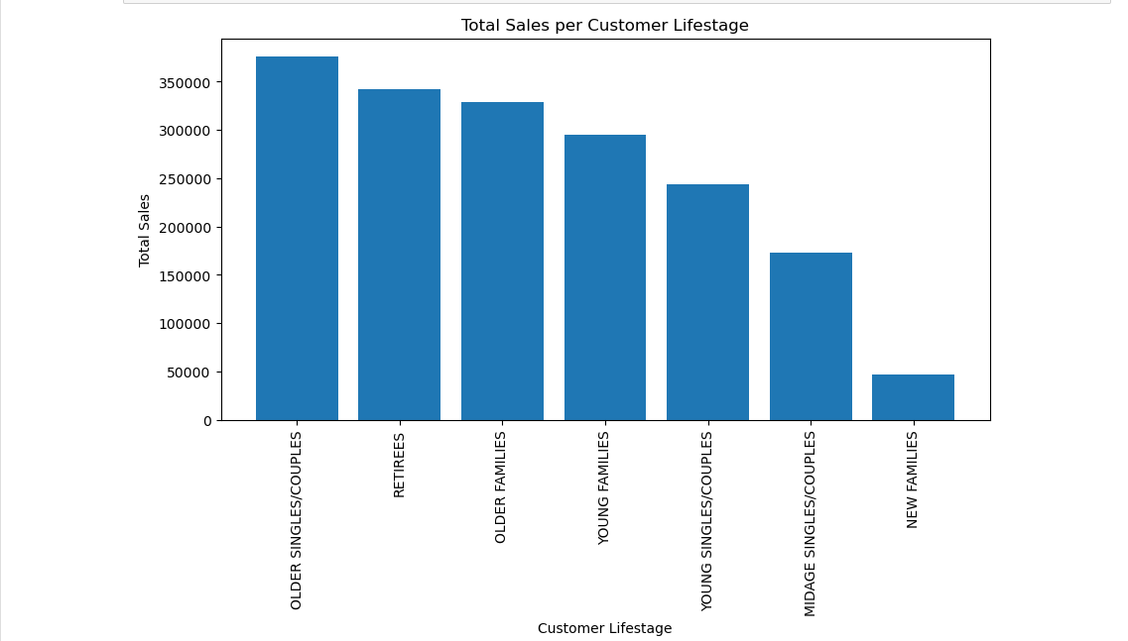
Most sales were generated by older singles/couples, retirees, and older families, while the least sales were from new families.

Slide 8
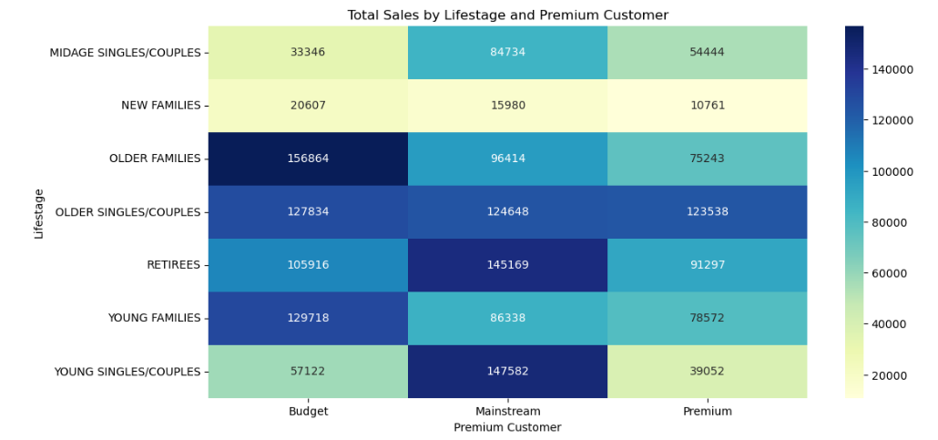
Budget-older families, mainstream- young couples/singles, and mainstream- retirees generated the most sales while premium-new families generated the least sales.

Slide 9
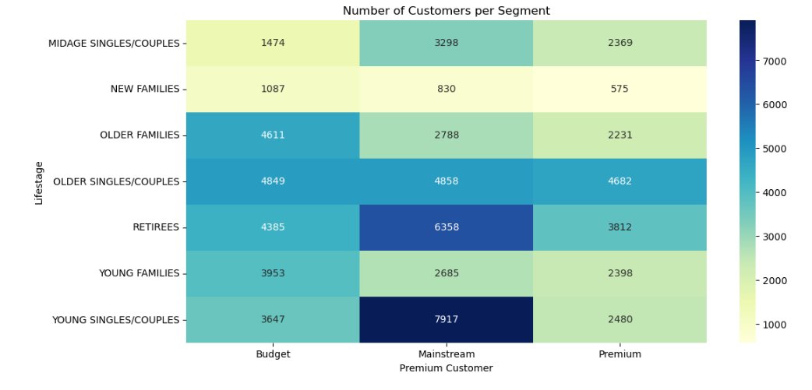
Mainstream- young couples/singles, mainstream- retirees, and budget-older families segments had the highest number of customers.

Slide 10
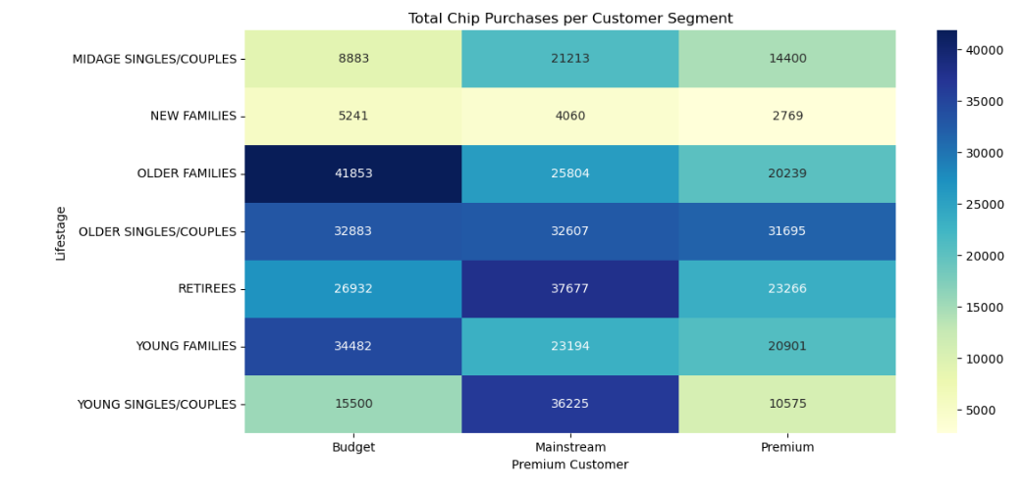
Budget- older families, mainstream- retirees, and mainstream- young singles/couples purchased more chips as compared to the rest of the segments

Slide 11
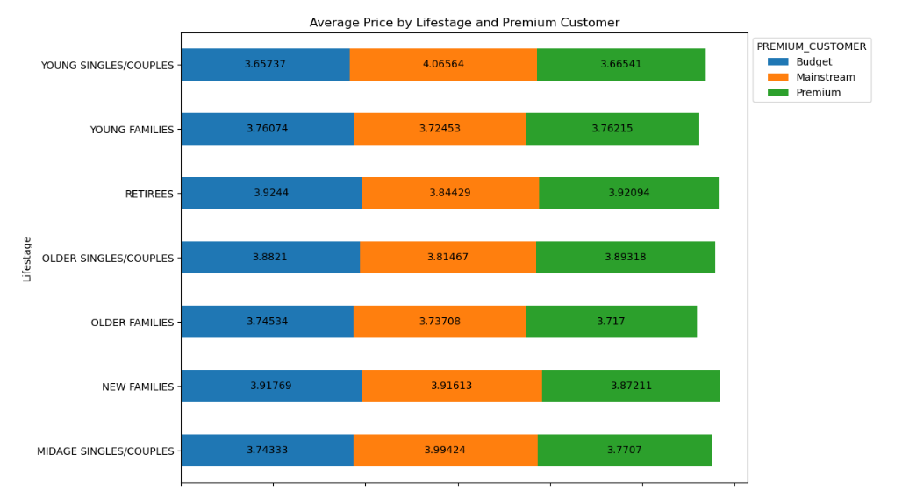
Mainstream - young singles/couples and mainstream – mid-age singles/couples are more willing to pay more per packet of chips compared to other customer segments.

Slide 12
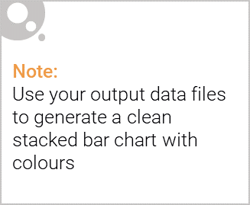
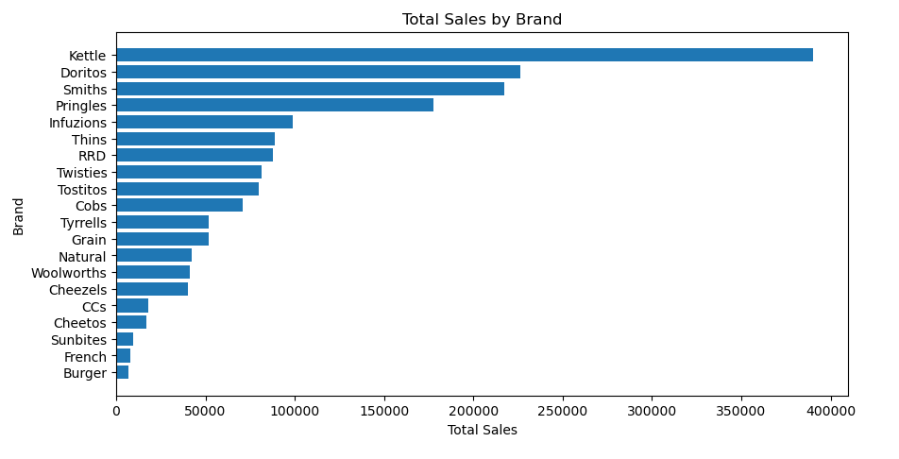
Editable (delete this)
Kettle, Doritos, and Smiths are the top 3 best selling chip brands

Slide 13
02
Trial store performance

Slide 14
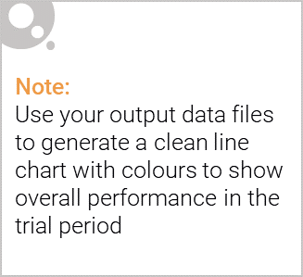
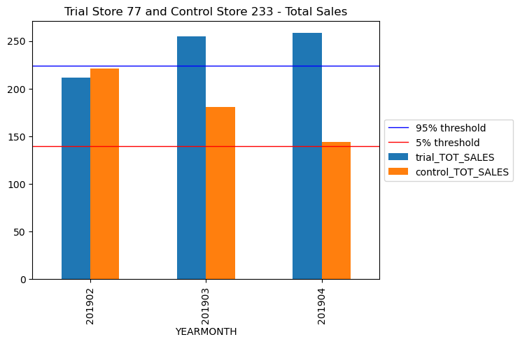
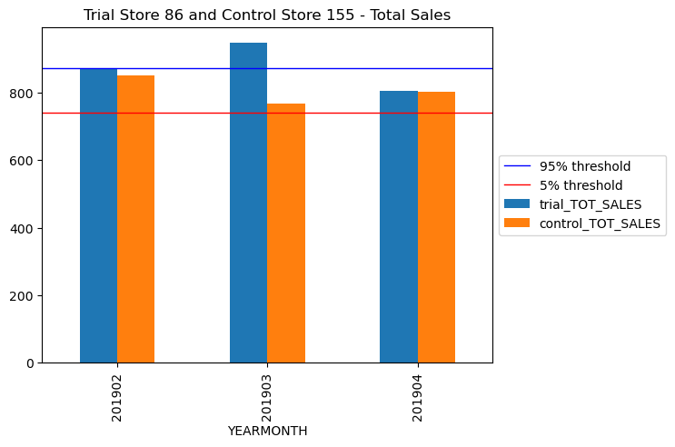
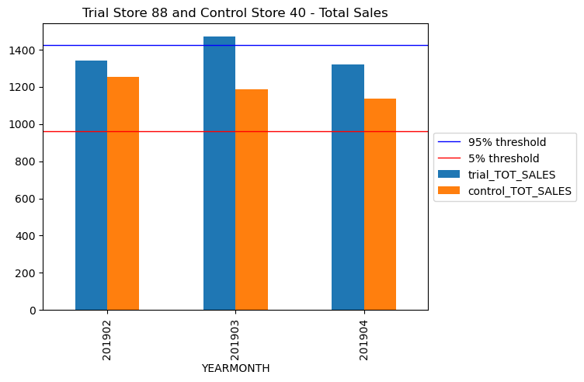
Trial store 77: Control store 233
Trial store 86: Control store 155
Trial store 88: Control store 40
Both trial store 77 and 86 showed a significant increase in total sales during the trial period. But not for trial store 88. Perhaps the client knows if there's anything about trial 88 that differs from the other two trials.

Slide 15
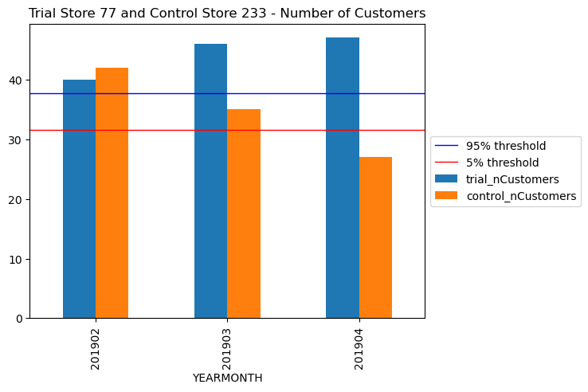
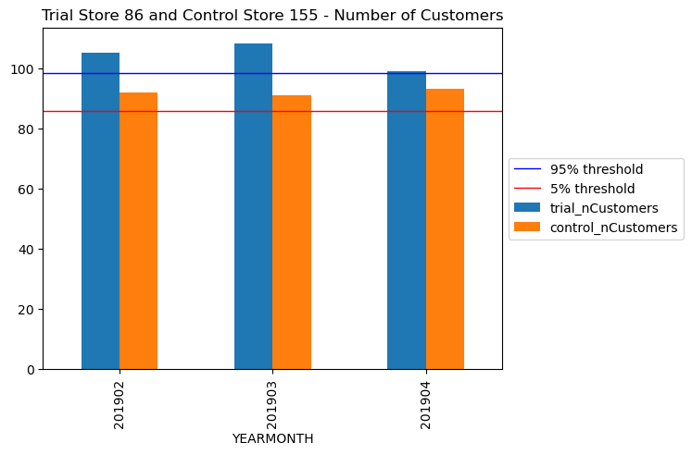
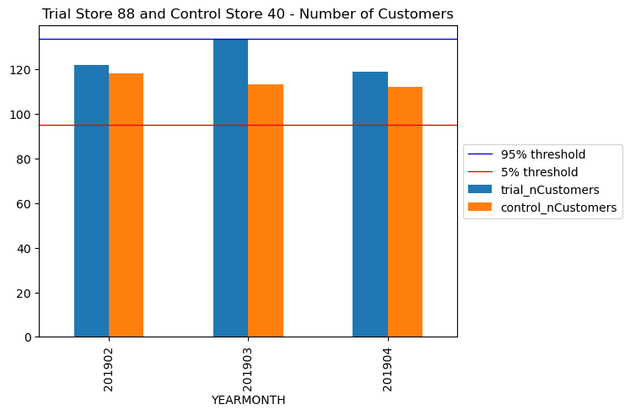
Trial store 77: Control store 233
Trial store 86: Control store 155
Trial store 88: Control store 40
Both trial store 77 and 86 showed a significant increase in the number of customers during the trial period. But not for trial store 88. Perhaps the client knows if there's anything about trial 88 that differs from the other two trials.

Slide 16
Conclusions
We've found control stores 233, 155, and 40 for trial stores 77, 86, and 88 respectively.
The results for trial stores 77 and 88 during the trial period show a significant difference in at least two of the three trial months but this is not the case for trial store 86.
We can check with the client if the implementation of the trial was different in trial store 86 but overall, the trial shows a significant increase in sales.
Recommendations
The company can capitalize on the categories that generate the most sales like the budget- older families, mainstream- young singles/couples, and mainstream- retirees.
Midage and young singles/couples are more likely to make impulse purchases and spend more per packet of chips. Mainstream young singles/couples buy more Kettle, Doritos, and Pringles chips than the rest of the chips. The Category Manager can increase visibility and impulse buying behavior by off-locating the top 3 chip brands and smaller packs of chips in discretionary spaces where young singles and couples frequent.
Quantium can provide recommendations on these segments and measure the impact of the changes to placement.

